Slide 1
Item #1: SGN 2024-0003 Sign Permit Review for Tractor Supply Company Planning Commission Meeting May 8, 2024

Slide 2
Project Description
Proposed wall and monument signs for the Tractor Supply Company associated with an existing Sign Program in the Mission Plaza Shopping Center
In the Planned Commercial Development (PCD) and the H Street Overlay (HSO) Zoning Districts
Notes:
Good evening, Chair Cioni and Commissioners;
I am presenting a request from Steve Fear, Coast Monument Signs for the review of proposed wall and monument signs for the Tractor Supply Company associated with an existing Sign Program in the Mission Plaza Shopping Center in the Planned Commercial Development (PCD) and H Street Overlay (HSO) zoning districts.

Slide 3
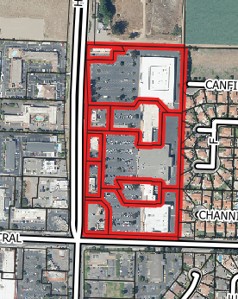
Project Location
432 Commerce Court
Notes:
The Mission Plaza Shopping Center is located at the Northeast Corner of North H Street and East Central Avenue, will be located at 1600 North H Street
The surrounding uses include:
North – Vacant Land (Rivers Edge Pet Lodge)
South - Commercial / PCD (Mission Plaza Shopping Center)
East – Residential
West - Commercial / PCD (Hotel)
The property fronts North H Street. Vehicular access to the site would be from the existing driveway approaches.

Slide 4
Signs Requiring Planning Commission Approval
Per the Mission Plaza Sign Program Section D (Major Tenants 1b) “Major tenants with total square feet of more than 30,000 square feet (Albertson's, Mervyn's, and Ross respectively) shall be allowed one (1) sign which may be a maximum allowed height of 48 inches and shall not exceed letter height of 48 inches except for logo in the Albertson’s sign, which shall be 60 inches.”
Notes:
Per the Mission Plaza Sign Program Section D states “All signage of Major Tenants shall be reviewed and approved by the City Planning Commission.”
(Major Tenants 1b) “Major tenants with total square feet of more than 30,000 square feet (Albertson's, Mervyn's, and Ross respectively) shall be allowed one (1) sign which may be a maximum allowed height of 48 inches and shall not exceed letter height of 48 inches except for logo in the Albertson’s sign, which shall be 60 inches.”
Sign permit reviews are typically completed by the Planning and Building Division through the Building Permit application process. The proposed signage by Tractor Supply Company was submitted under Building Permit B2024-0113 and was approved by the Building Division on March 21, 2024.
The Planning Division could not approve the permit and indicated in written plan check corrections that Major Tenant signs required Planning Commission review and approval in accordance with section D (Major Tenants) of the sign program that states in pertinent part, “All signage of Major Tenants shall be reviewed and approved by the City Planning Commission.”

Slide 5
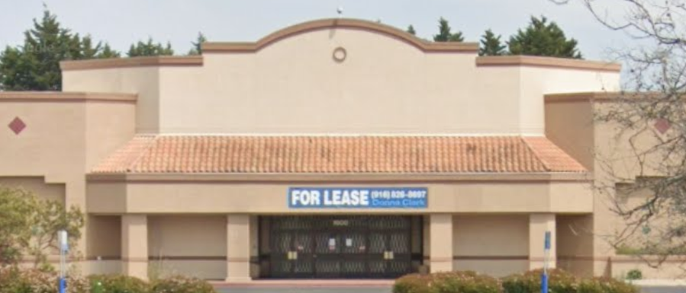
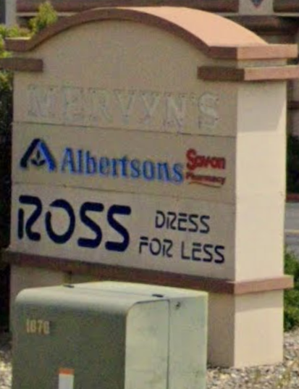
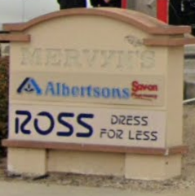
Existing Conditions
Notes:
Here are photographs of the existing building and monument signs

Slide 6
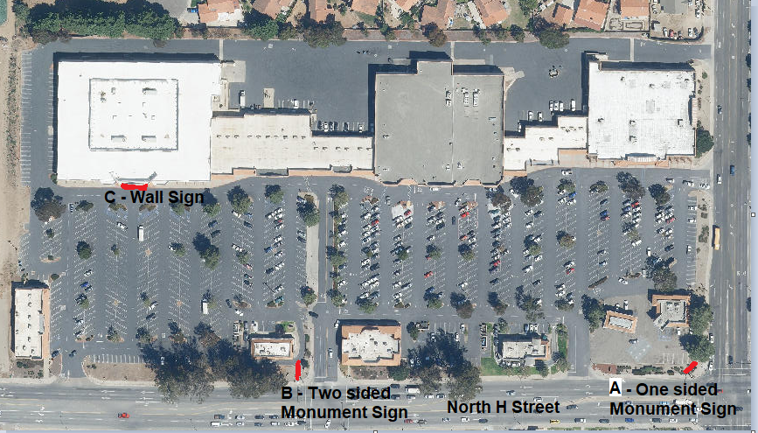
Proposed Sign Locations
Notes:
Site Plan showing the location of the signs.
Sign A –
Sign B –
Sign C –

Slide 7
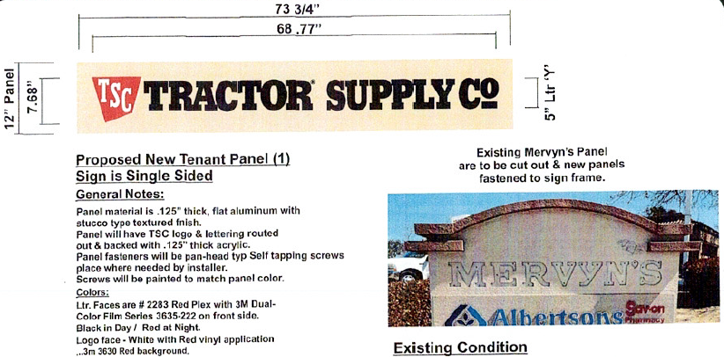
Proposed Monument Sign Modifications
Notes:
Sign A
Installation of one (1) sign panel on an existing one sided monument sign located on the corner of North H Street and East Central Avenue with letters measuring 12 inches by 73 ¾ inches
Tractor Supply is proposing new panels (signs A & B) as described above on the two existing monument signs along H Street as shown on the site plan in the attached plan set. The sign letter height would be 5 inches and the letters would be black in color with a red logo. The background of the sign would be stuccoed and painted to match the existing sign cabinet. Signage on the monument signs is generally utilized to identify the major tenants in the shopping center.

Slide 8
Proposed Monument Sign Modifications
Notes:
Sign B
Installation of two (2) sign panels on an existing two sided monument sign located on the west side of the Mission Plaza Shopping Center driveway entrance off of North H Street with letter measuring 16 inches by 98 inches.

Slide 9
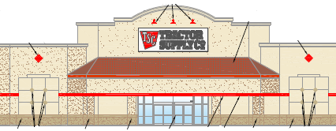
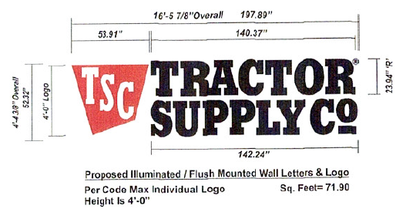
Proposed Major Tenant Wall Sign
Notes:
Sign C
Installation of one (1) wall sign measuring 48 inches tall and 23.94 inches wide with illuminated channel letters to be located on the existing building located at 1600 North H Street in the Mission Plaza Shopping Center.
Sign C is a wall sign proposed on the west face of the building visible from H Street consisting of one (1) 48 inch tall logo with a red background with TSC in white letters and text reading Tractor Supply Co on two lines of text consisting of flush mounted internally illuminated, individual black channel color-changing letters (black during daylight, and white when illuminated at night), for a total sign area of 71.9 square feet.
Staff review finds that the proposal of monument panels with the proposed text of 5 inches meet the requirements listed in the sign program that requires that letters be no more than 9 ¾ inches for the panels on the monument sign on North H Street and letters of no more than 7 ¼ inches for the panel on the monument sign on at the corner North H Street and East Central Avenue. For the proposed wall sign which contains a 48 inch logo and channel letters that are 23.94 inches in height (47.88 inches double stacked height), these dimensions do not exceed the allowed maximum of 48 inches per the sign program

Slide 10
Environmental Review
This action is exempt from environmental review pursuant to Section 15061 (b)(3) (Review for Exemption) of the California Environmental Quality Act (CEQA) Guidelines.
Notes:
This action is exempt from environmental review pursuant to Section 15061 (b)(3) (Review for Exemption) of the California Environmental Quality Act (CEQA) Guidelines. No further environmental review is required, and a Notice of Exemption will be filed for the project following the Planning Commission’s action.

Slide 11
Staff Recommendation
Adopt Resolution No. 1003 (24) approving SGN 2024-0003;
OR
Provide other direction
Notes:
Staff review finds that the proposal of monument panels with the proposed text of 5 inches meet the requirements listed in the sign program that requires that letters be no more than 9 ¾ inches for the panels on the monument sign on North H Street and letters of no more than 7 ¼ inches for the panel on the monument sign on at the corner North H Street and East Central Avenue. For the proposed wall sign which contains a 48 inch logo and channel letters that are 23.94 inches in height (47.88 inches double stacked height), these dimensions do not exceed the allowed maximum of 48 inches per the sign program
As depicted and described in the attached proposed Sign Plan Set, the proposed signs meet the Sign Standards of the Zoning Code, Mission Plaza Sign Program, and the City’s Architectural Review Guidelines.
and therefore, staff recommends that the Planning Commission adopt Resolution No. 1003 (24) Sign Review Permit (DR 2024-00034) based on the findings in the resolution.
Thank you, that concludes my presentation, and I am available for questions. Now Brian Halvorson, Planning Manager has information regarding other sign programs that have similar requirements.

Slide 12
End of Presentation

