Slide 1
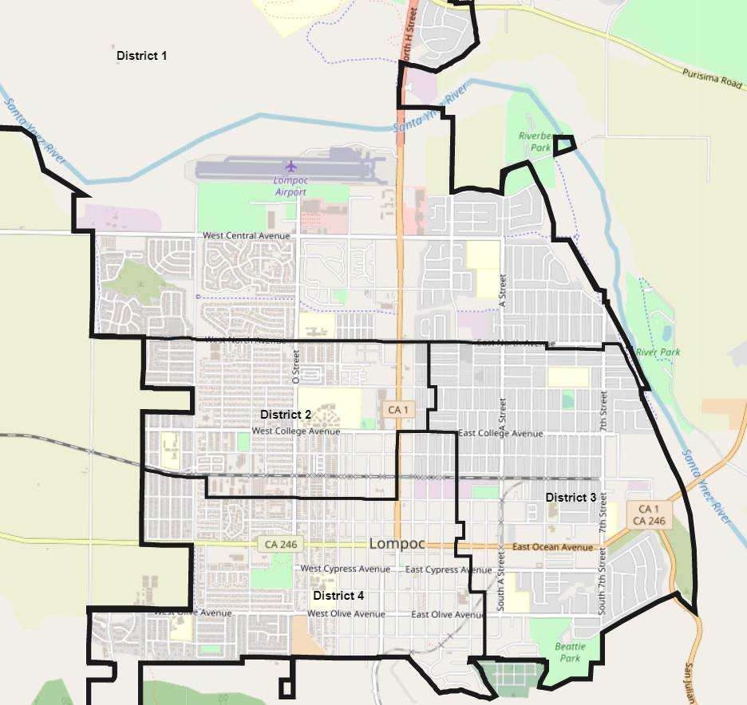
City of Lompoc 2021/22 Redistricting Dr. Daniel Phillips Consultant, National Demographics Corporation

Slide 2
Redistricting Process
Step | Description
Two pre-draft hearings: July 6 & 20, 2021 | Held prior to the release of draft plans. Purpose is to educate on the process and to solicit input on the neighborhoods and communities of interest in the City.
Update on 2020 Census results: November 2, 2021 | Report on official demographics data for the existing city council districts.
Two post-draft hearings: Feb. 2 & 16, 2022 | Purpose is to present, discuss, and, if necessary, revise the draft plans, and to discuss the election sequence.
Plan adoption: March 1, 2022 | Plan adopted via ordinance.

Slide 3
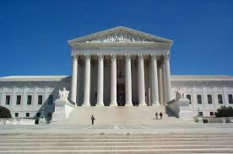
Redistricting Rules and Goals
1. Federal Laws
2. California Criteria for Cities
3. Other Traditional Redistricting Principles
Equal Population
Federal Voting Rights Act
No Racial Gerrymandering
Geographically contiguous
Undivided neighborhoods and “communities of interest” (Socio-economic geographic areas that should be kept together)
Easily identifiable boundaries
Compact (Do not bypass one group of people to get to a more distant group of people)
Prohibited:
“Shall not favor or discriminate against a political party.”
Minimize voters shifted to different election years
Respect voters’ choices / continuity in office
Future population growth
Preserving the core of existing districts

Slide 4
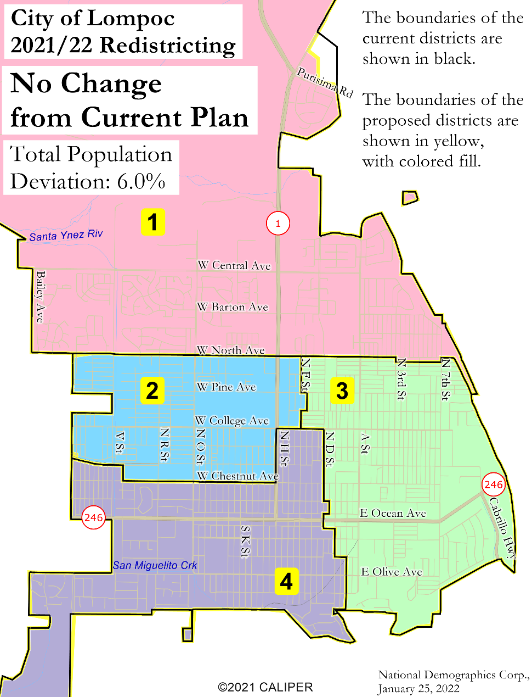
Option 1: Accept Current Districts with No Changes
Total population deviation: 6.0%
No voting rights concerns, as the districts are effective in electing candidates from protected classes
All districts are contiguous
No testimony received that the districts divide neighborhoods or communities of interest
Some boundaries may not be easily identifiable due to some seemingly arbitrary small diversions from straight lines
All districts seem to be compact
Most future growth is expected in Districts 1 and 3, but District 4 is the most underpopulated (–2.3%)

Slide 5
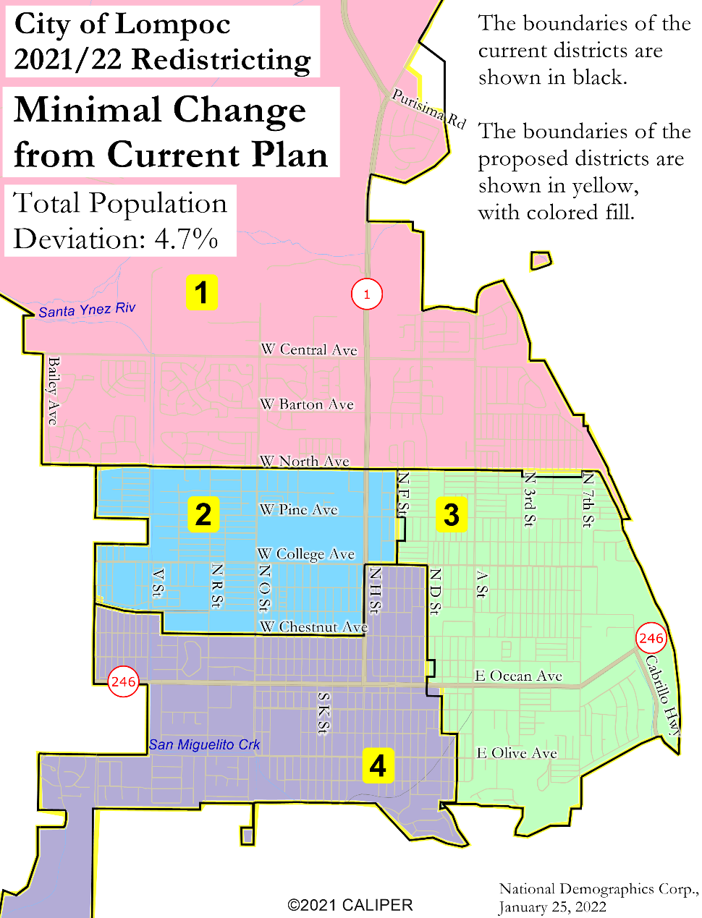
Option 2: Modify Current Districts with Minimal Changes
Total population deviation: 4.7%
No appreciable difference from the current districts in terms of voting rights, contiguity, neighborhood/ COI integrity, or compactness
0.2% of the city’s population shifts to an earlier election
No difference from the current districts in terms of continuity of office or the core of each district
Most future growth is expected in Districts 1 and 3, but District 4 is the most underpopulated (–2.5%)

Slide 6
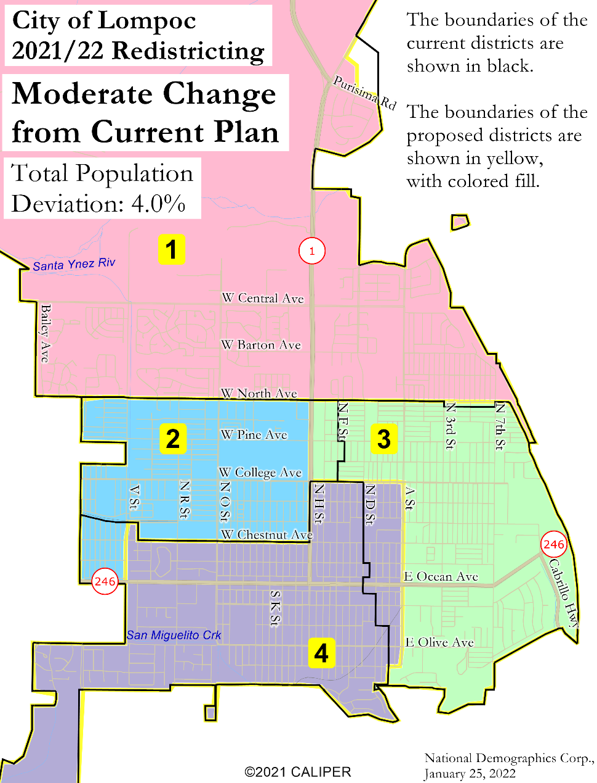
Option 3: Modify Current Districts with Moderate Changes
Total population deviation: 4.0%
No appreciable difference from the current districts in terms of voting rights, contiguity, neighborhood/ COI integrity, or compactness
Boundaries may be more easily identifiable due to shift of some boundaries to alternate streets
1.8% shifts to an earlier election, 2.7% shifts to a later election
No difference from the current districts in terms of continuity of office or the core of each district
Most future growth is expected in Districts 1 and 3, and they are the two underpopulated districts

Slide 7
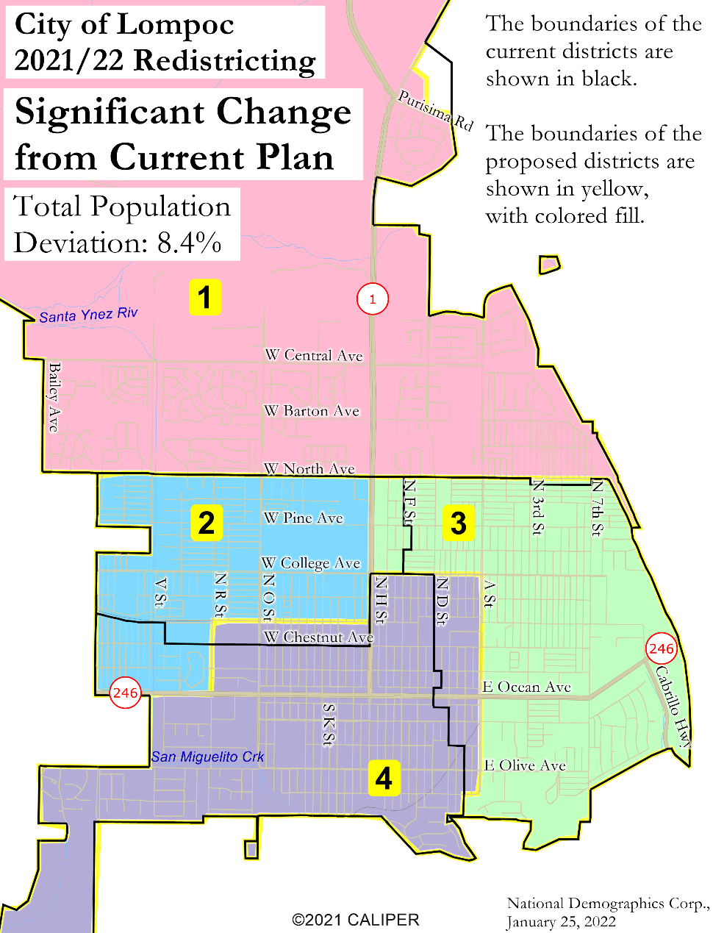
Option 4: Modify Current Districts with Significant Changes
Total population deviation: 8.4%
No appreciable difference from the current districts in terms of voting rights, contiguity, neighborhood/ COI integrity, or compactness
Boundaries may be more easily identifiable due to shift of some boundaries to alternate streets
4.0% shifts to an earlier election, 5.7% shifts to a later election
No difference from the current districts in terms of continuity of office or the core of each district
Most future growth is expected in Districts 1 and 3, but District 2 is the most underpopulated (–3.2%)

Slide 8
Public Hearing & Discussion
Questions about the proposed redistricting plans?
Which plan do you prefer?
What, if anything, would you like to see revised in your preferred plan?
Please refer to the Interactive Review Map for a detailed look at each plan

